Slide 1
WEARINASIA (WEARABLE, DRONE, and iot e-business)
Group 1 :
Ian andika dinanendra simbolon
Muhamad hudya ramadhana
Mutia ayu dianita

Slide 2

BACKGROUND

Slide 3

History of e-business

Slide 4

History of e-commerce

Slide 5

Profile of wearinasia.com

Slide 6
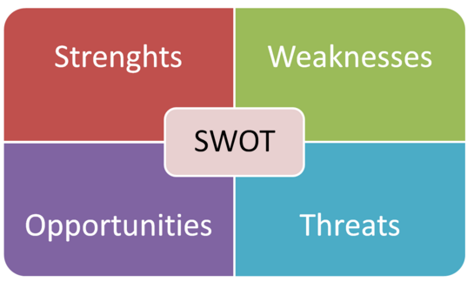
Theory of swot analysis

Slide 7
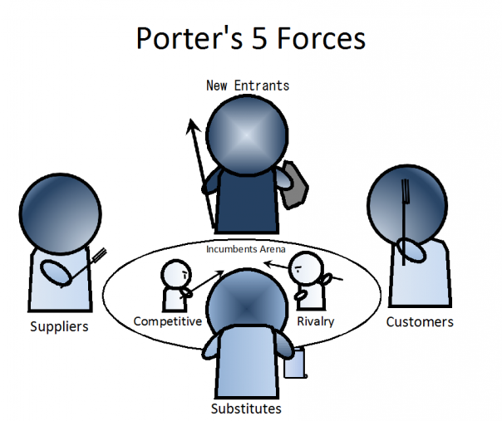
THEORY of five forces porter

Slide 8

Key partnership of wearinasia.com

Slide 9

Payment system of wearinasia.com

Slide 10
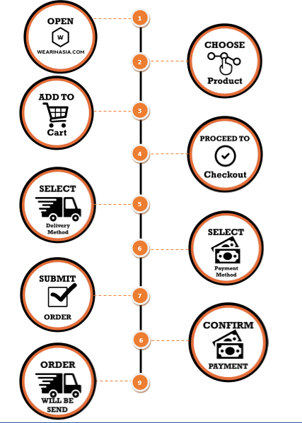
Shopping mecanism of wearinasia.com

Slide 11

Revenue stream

Slide 12
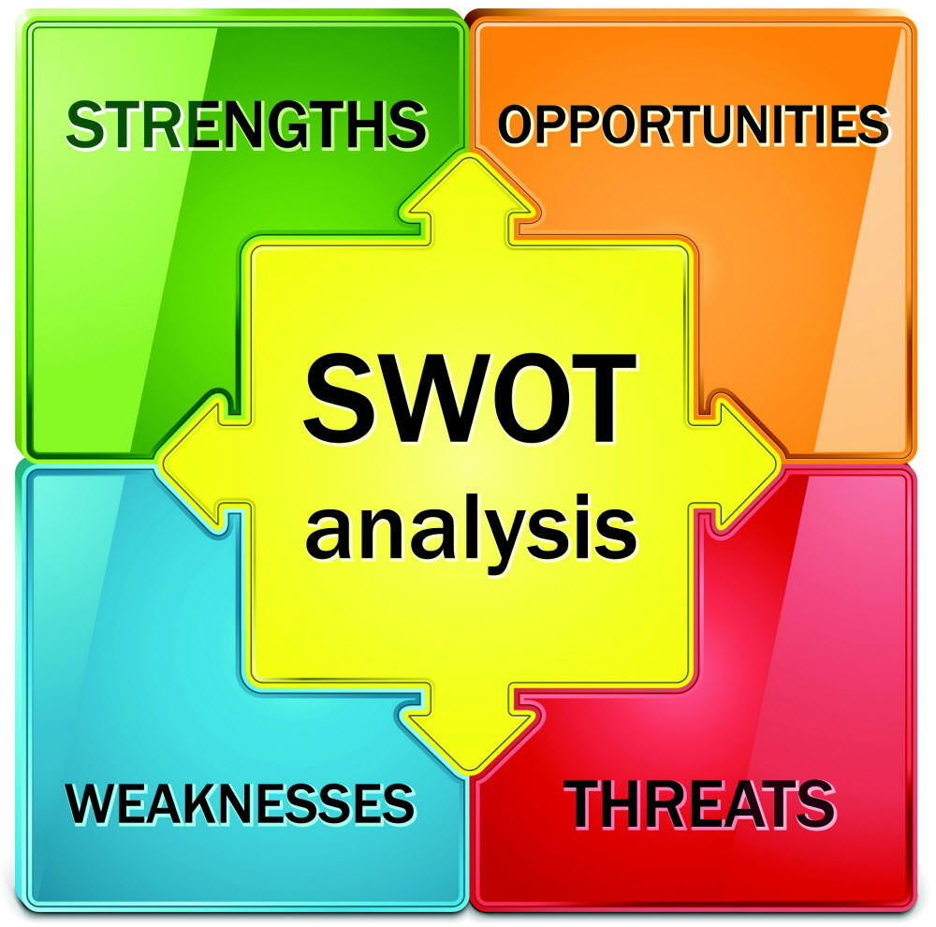
Swot analysis

Slide 13
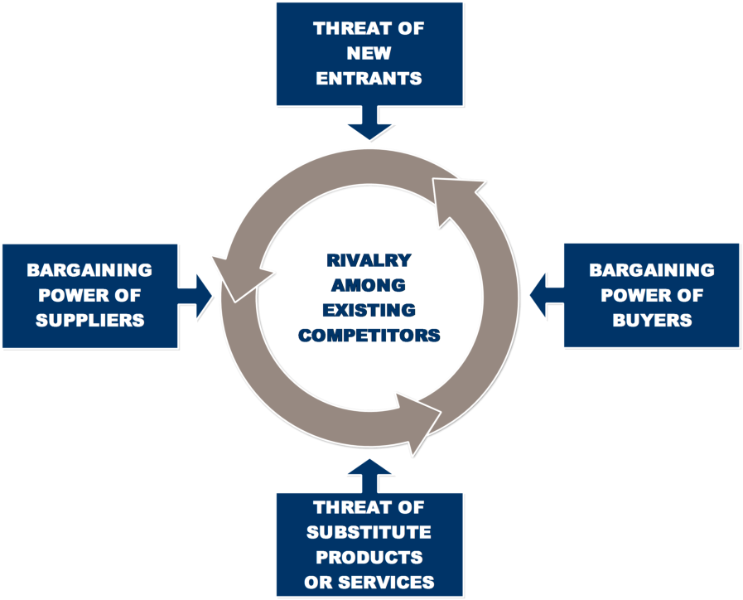
Five forces porter

Slide 14

Conclusion and suggestion

